Slide 1


Team 70: VFD Motor Controller
Bi-Weekly Update 4
Mackenzie Miller
Andrew Nguyen
Aidan Rader
Ryan Regan Sponsor: John Lusher TA: Ali Alenezi
Notes:
Mackenzie
Guidance on preparing status update 3:
-Theme of this presentation is Functional System Testing, which shows that what you have integrated works!. In industry this would correspond to a System Test Plan Document
-This update should cover what was accomplished in weeks 5 & 6 and what is planned for weeks 7 and 8 (This period is Integration + System Test)
-Subsystem issues identified as a problem in status update 2 should be resolved by now. You can briefly present their resolution in update 3 – not too much detail
-Functional system tests should be developed (before next update) and conducted (may take additional weeks) to test what you have integrated. Subsystem (aka Unit) testing should be done already, mostly in 403!
-A functional test plan includes a number of tests each with: what is being tested, what equipment is being used to test, test configuration / hookup, test procedures, test inputs/data, and results (date, time, person(s) who did test, quantitative results (csv, waveforms, tables, …). The status update should focus on Functional System Test purposes/dates/results.
-We will cover Exception Testing, which includes test-to-fail/error handling and Requirements Validation Testing (range testing to satisfy requirements from FSR) in Status Update 4.

Slide 2
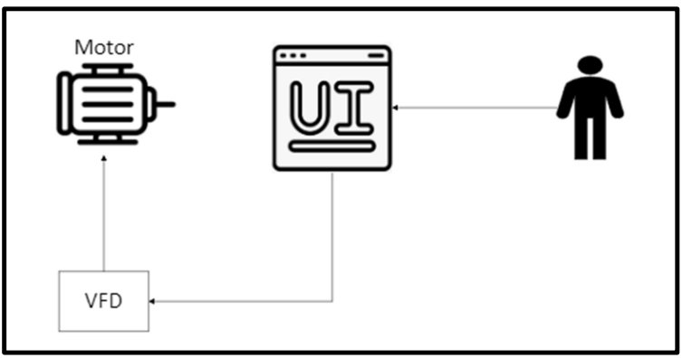
Project Summary
Problem: Traditional motor control systems cannot adjust to varying load demands, resulting in poor energy efficiency, excessive heat generation, and premature component failure
Solution: Develop a Variable Frequency Drive (VFD) motor control system to adjust frequency and voltage to load demands
Notes:
Mackenzie
30 seconds
What is the problem that we are solving
High-level summary of what system does to solve the problem
Picture / Diagram here

Slide 3
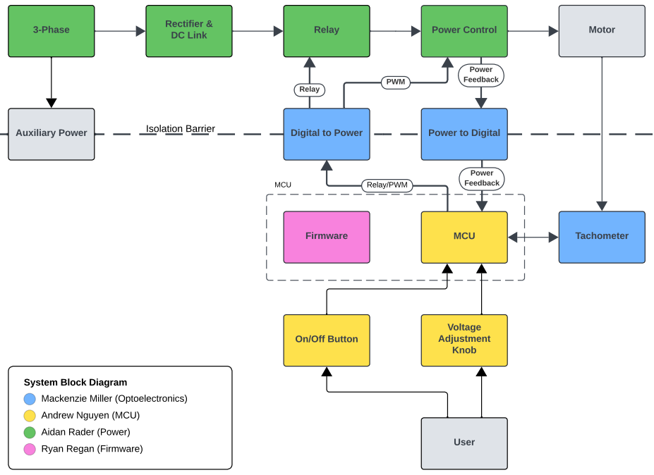
Project/Subsystem Overview
Notes:
Aidan
30 seconds
Diagram showing subsystems – with labels showing subsystem owners

Slide 4
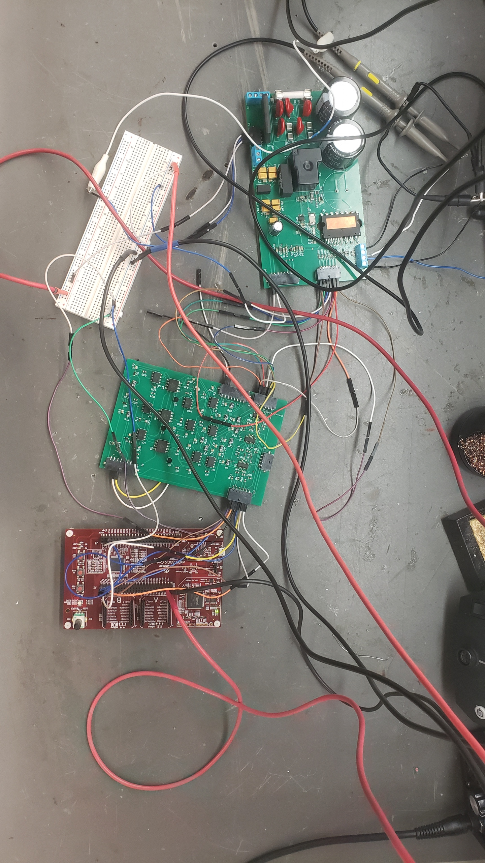
Project/Subsystem Overview
Notes:
Aidan
30 seconds
Diagram showing subsystems – with labels showing subsystem owners

Slide 5
Project Timeline
2/12 | 2/19 | 3/7 | 3/19 | 4/2 | 4/16 | 4/28
Subsystem PCBv1 Design, Assembly, & Testing | Auxiliary Power & MCU/Firmware Integration | PWM Control Integration | System Integration | System Testing | System Validation | Demo, Showcase, & Report
Notes:
Aidan
45 seconds
Diagram showing subsystems – with labels showing subsystem owners

Slide 6
Optoelectronics
Mackenzie Miller
Accomplishments since last update 27 hrs of effort | Ongoing progress/problems and plans until the next presentation
PWM Control integration (Dev) Relay Control Integration (Dev) | Power Feedback Integration Unexpected Voltage Drop Complete PWM integration (MCU) Relay Control (MCU) Order Tachometer
Notes:
Mackenzie
45 seconds
For 3nd review Accomplishments should include what integration was completed and what functional system test (testing of what you integrated) has been completed. Include resolution of any KEY subsystem issues.
“Completed integration of MCU with Lidar camera”
“Completed testing of integrated motor controller and MCU for forward high speed and low speed and reverse movement”
“ON-GOING functional testing of complete system including vision system, navigation, obstacle avoidance, and object detection”
“Full system integration will be completed by next review”

Slide 7
Microcontroller
Andrew Nguyen
Accomplishments since last update 24 hrs of effort | Ongoing progress/problems and plans until the next presentation
Found the Pickit4 to be faulty and got a new Pickit5 MCU was detected by Pickit5 MCU generates PWM signals | Order new board and parts Fully integrate with firmware Verify the 15V AC/DC converter works Connect to optoelectronics board to send PWM signals using the firmware code
Notes:
Andrew
45 seconds
For 3nd review Accomplishments should include what integration was completed and what functional system test (testing of what you integrated) has been completed. Include resolution of any KEY subsystem issues.
“Completed integration of MCU with Lidar camera”
“Completed testing of integrated motor controller and MCU for forward high speed and low speed and reverse movement”
“ON-GOING functional testing of complete system including vision system, navigation, obstacle avoidance, and object detection”
“Full system integration will be completed by next review”

Slide 8
Power
Aidan Rader
Accomplishments since last update 40 hrs of effort | Ongoing progress/problems and plans until the next presentation
Integrated PWM Control with Optoelectronics and Firmware Integrated Relay Control with Optoelectronics and Firmware Blue-wired trace errors 3* Power control outputs * 3 to motor connector Relay output to power control input | Integrating Auxiliary Power with Optoelectronics Integrating PWM Control with Microcontroller Integrating Relay Control with Microcontroller Integrate Power Feedback Needs PWM Control Integrated System Integration Update Validation Plan/Tests System Tests
Notes:
Aidan
45 seconds
For 3nd review Accomplishments should include what integration was completed and what functional system test (testing of what you integrated) has been completed. Include resolution of any KEY subsystem issues.
“Completed integration of MCU with Lidar camera”
“Completed testing of integrated motor controller and MCU for forward high speed and low speed and reverse movement”
“ON-GOING functional testing of complete system including vision system, navigation, obstacle avoidance, and object detection”
“Full system integration will be completed by next review”

Slide 9
Firmware
Ryan Regan
Accomplishments since last update 22 hrs of effort | Ongoing progress/problems and plans until the next presentation
Implemented Relay control with button Successfully flashed code onto microcontroller | Replace dev board with microcontroller in completed/ongoing integrations Fix problem with MCU potentiometer/strange PWM duty cycles Validate output of PWM control integration Begin full system testing
Notes:
Ryan
45 seconds
For 3nd review Accomplishments should include what integration was completed and what functional system test (testing of what you integrated) has been completed. Include resolution of any KEY subsystem issues.
“Completed integration of MCU with Lidar camera”
“Completed testing of integrated motor controller and MCU for forward high speed and low speed and reverse movement”
“ON-GOING functional testing of complete system including vision system, navigation, obstacle avoidance, and object detection”
“Full system integration will be completed by next review”

Slide 10
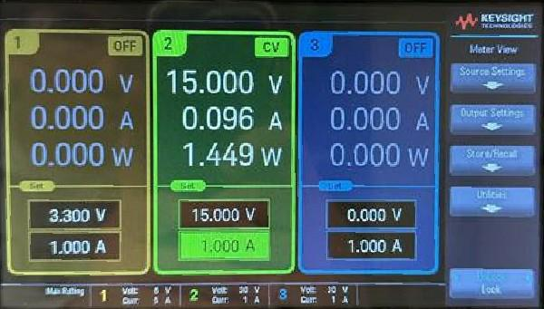
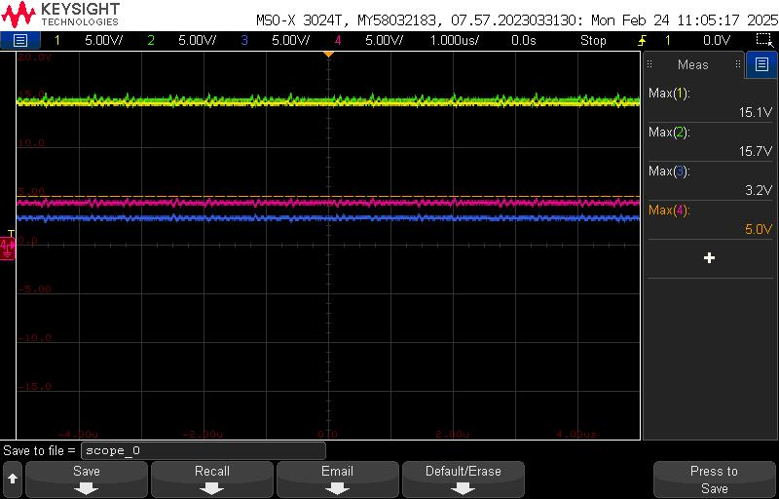
Auxiliary Power Integration Optoelectronics, Microcontroller, & Power Mackenzie Miller, Andrew Nguyen, & Aidan Rader
Converter | V_{in} [V] | V_{out,measured} [V]
2-Phase to 15V
15V to Iso15V | 15.0 | 15.7
15V to 3.3V | 15.0 | 3.2
3.3V to Iso5V | 3.2 | 5.0
Component | V_{in,min} [V] | V_{in,max} [V] | V_{in,measured} [V]
Power to Digital | 0.0 | 30.0
Relay | 11.25 | 16.5 | 15.7
Power to Digital | 0.0 | 30.0 | 15.7
Power Control | 14.5 | 18.5 | 15.7
MCU | 3.0 | 3.6 | 3.2
Digital to Power | 2.5 | 5.5 | 3.2
Digital to Power | 2.5 | 5.5 | 5.0
Power Control |  |  | 5.0
Auxiliary Power Integration Cont. ->

Slide 11
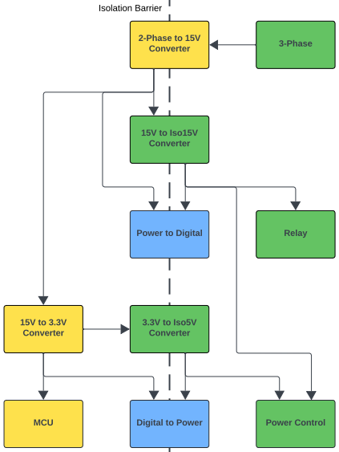
Auxiliary Power Integration Optoelectronics, Microcontroller, & Power Mackenzie Miller, Andrew Nguyen, & Aidan Rader
2-Phase to 15V Converter:
Requires testing, but only above 85 V_{AC}
With Resistor Loads:
Working
With Component Loads:
Not working
Problem narrowed down to Optoelectronics
Power to Digital turns Iso15V from 15.7 V to ~2.9V
Power to Digital turns 15V from 15.7 V to ~2.9V

Slide 12
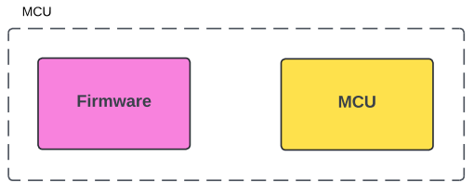
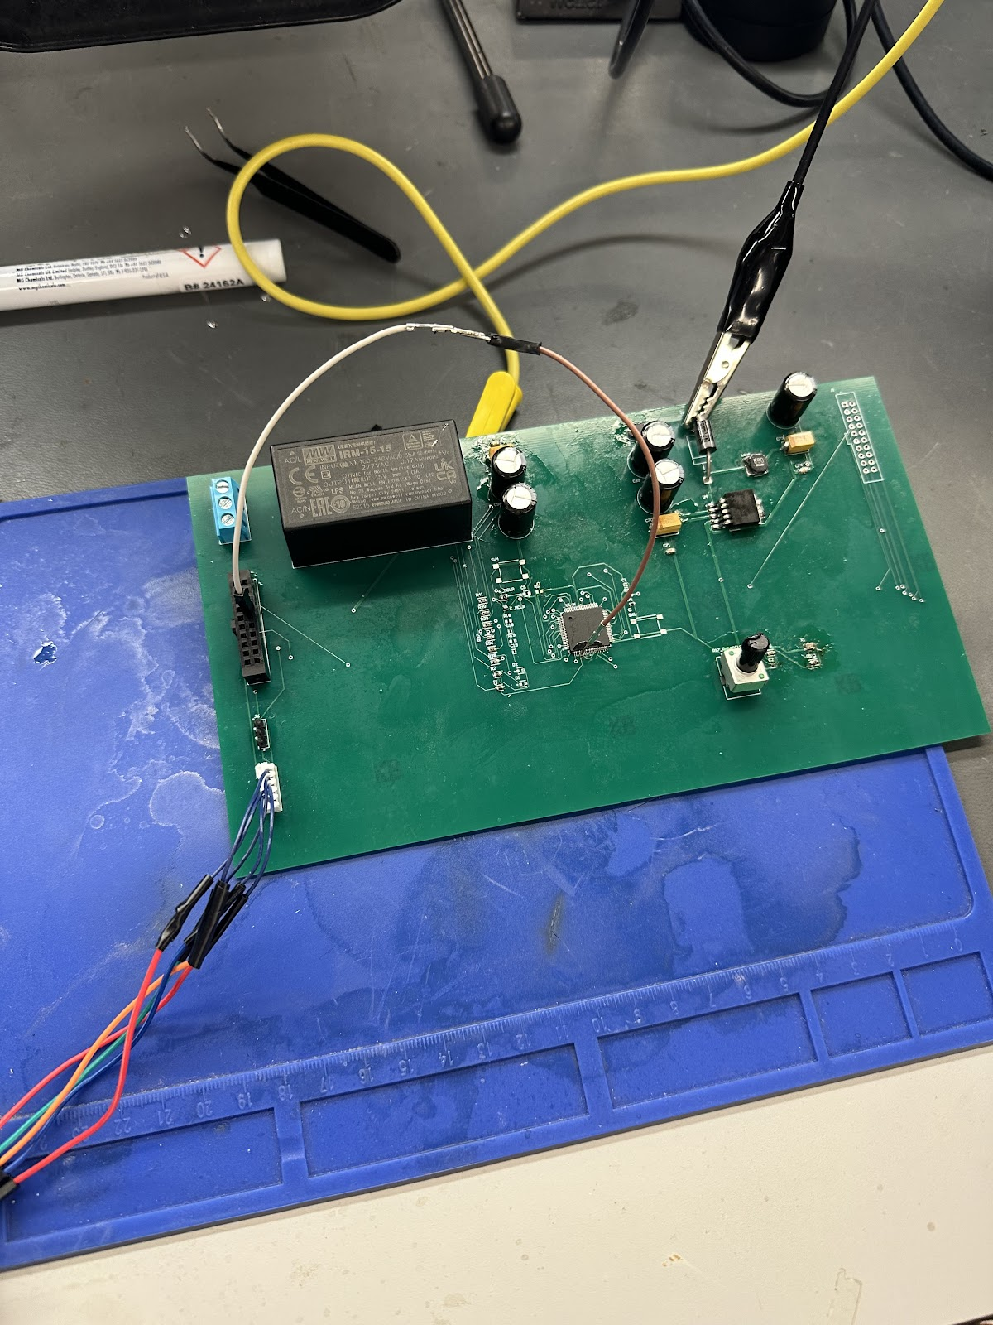
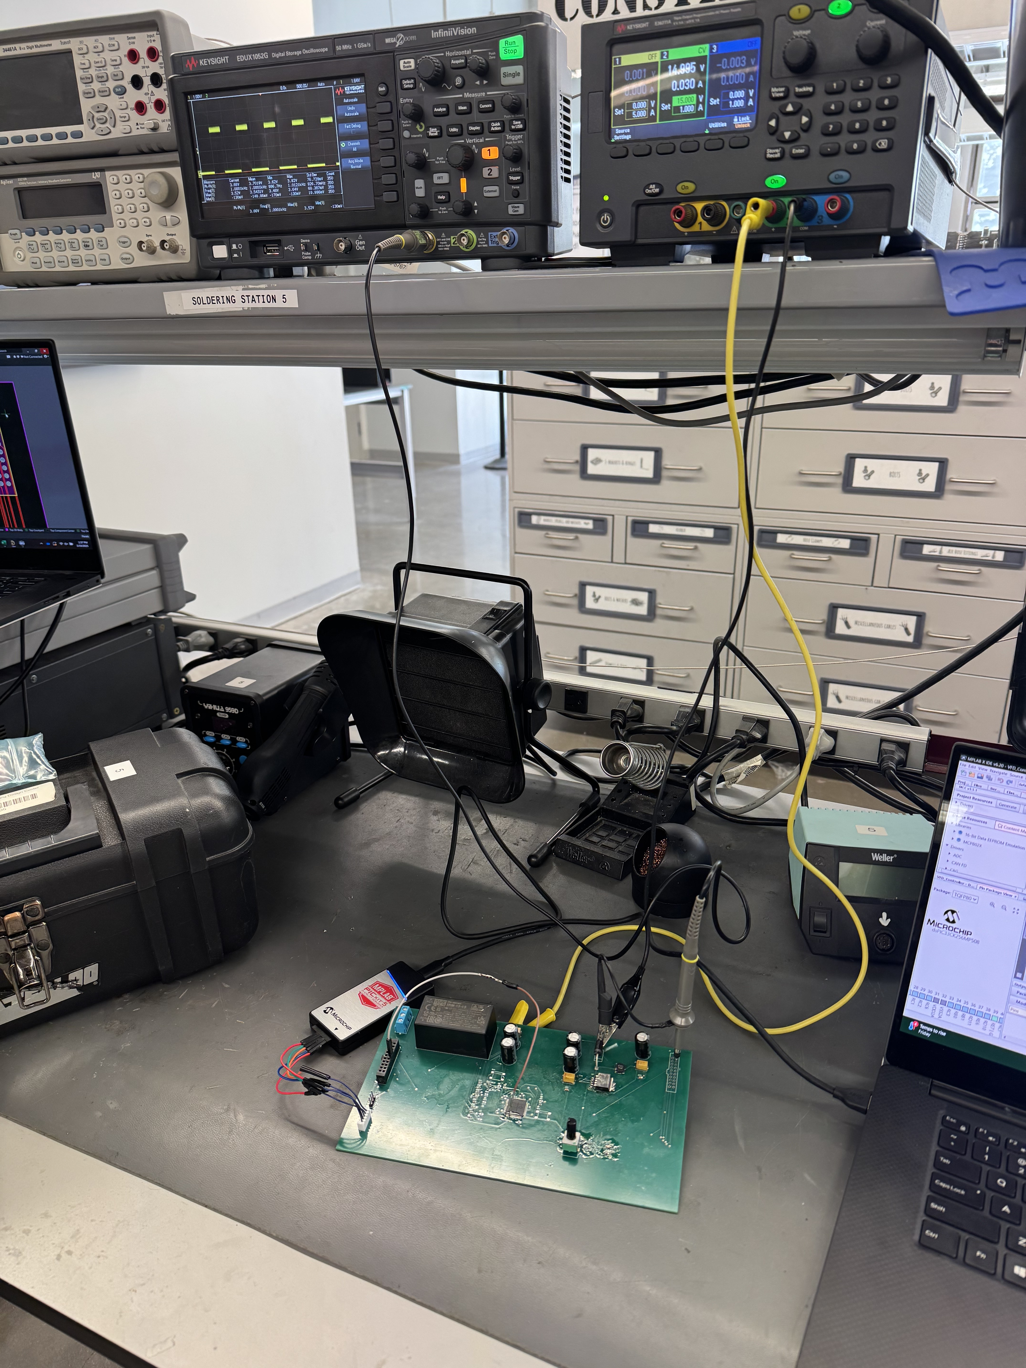
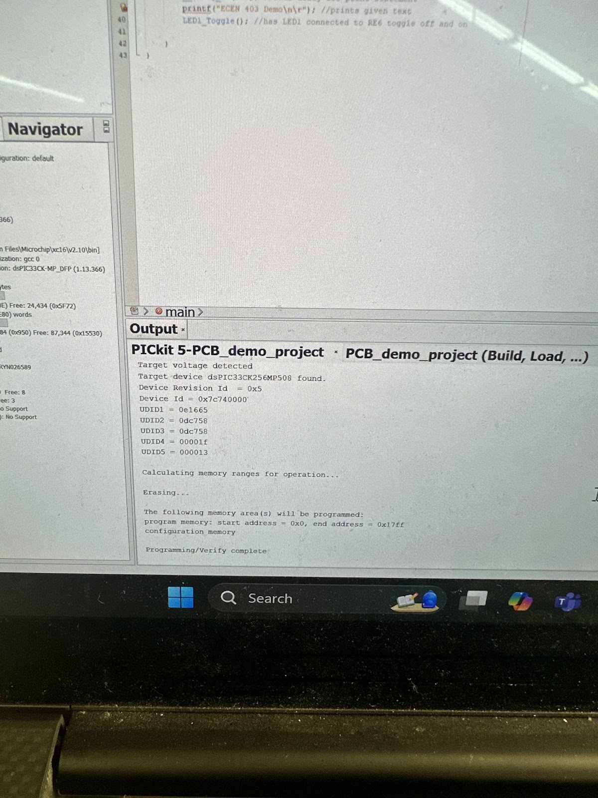
MCU/Firmware Integration Microcontroller & Firmware Andrew Nguyen & Ryan Regan
Successfully uploaded code
Used a jumper wire from the AVDD pin to the connector to give it 3.3V

Slide 13
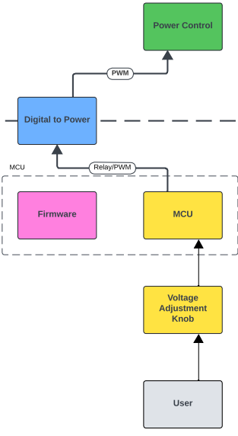
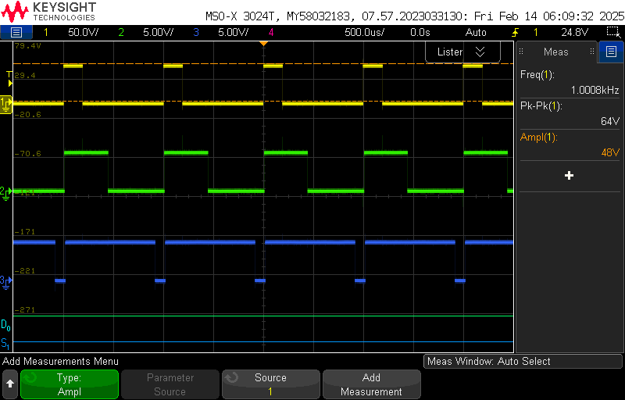
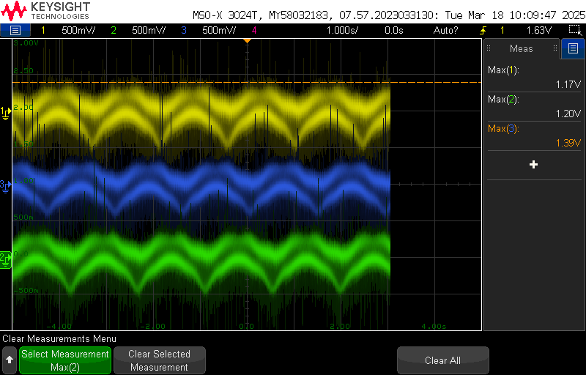
PWM Control Integration Optoelectronics, Power, & Firmware Mackenzie Miller, Aidan Rader & Ryan Regan
Firmware (Dev Board) -> Optoelectronics -> Power:
3.3V Square Wave: working
5V Square Wave: working
3-Phase Sine Waves: working
Microcontroller:
Integration not working
Dev Board
Dev Board
Notes:
Aidan

Slide 14
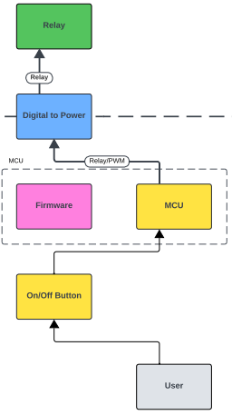
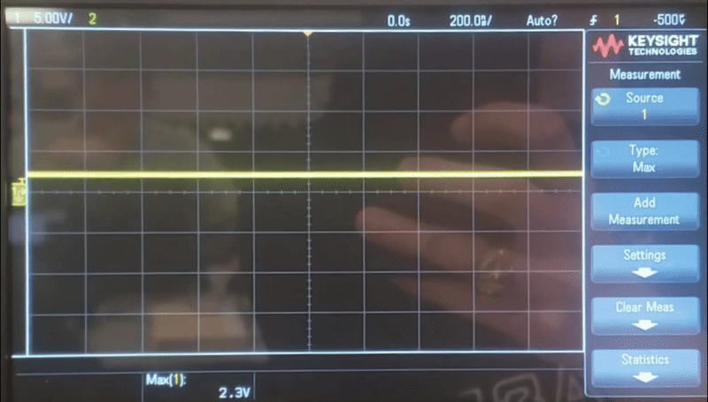







Relay Control Integration Optoelectronics & Firmware Mackenzie Miller & Ryan Regan
Firmware (Dev Board) -> Optoelectronics -> Power:
Working
Power:
Replaced fried diode
Reversed diode direction
Replaced fried MOSFET
Dev Board
Dev Board

Slide 15
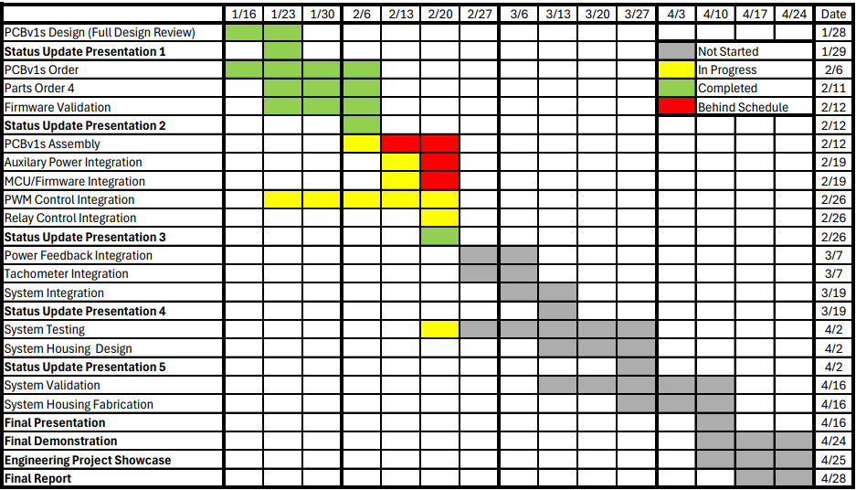
Execution Plan
Notes:
Aidan
30 seconds
Execution plan:
-Your team planned milestones for completion of any remaining integration of specific subsystems, functional test, and validation plans should be presented.
-Milestones should have owners … functional system testing, and full system integration can be group owned
-Gantt chart.

Slide 16
Validation Plan
Paragraph # | Test Name | Success Criteria | Methodology | Status | Responsible Engineer(s)
3.2.1.1 | Speed and Torque Requirement | Motor shall operate within speed range of 0RPM to 1800RPM and torque range of 0lb-ft to 0.729lb-ft. | Input motor with voltage and check if it achieves 0RPM and 0lb-ft . Repeat for 300RPM, 600RPM, 900RPM, 1200RPM, 1500RPM, 1800RPM. | Untested | Andrew, Ryan
3.2.1.2 | Frequency Requirement | System shall operate within frequency range of 5Hz to 60Hz. | Input system with frequency generator set to 5Hz and check if the motor runs smoothly. Repeat for 10Hz, 20Hz, 30Hz, 40Hz, 50Hz, 60Hz. | Untested | All
3.2.1.3 | Temperature Requirement | System shall operate within temperature range of 0˚C to 70˚C. | Place system in freezer set to 0˚C and check if the motor runs smoothly. Repeat with oven set to 70˚C. | Untested | All
3.2.3.2 | Input Voltage Level | System input voltage shall be 208V_{AC}. | Measure with multimeter and check if the voltage is 208V_{AC}. | Untested | Aidan
3.2.3.3 | Input Noise and Ripple | System shall not exceed ripple range of 0V to 0.165V. | Measure with multimeter and check if the voltage exceeds 0V to 0.165V. | Untested | Andrew
3.2.3.4 | External Commands | External commands shall be documented in appropriate ICD. | Show to teaching team and check with them for approval. | Untested | All
3.2.3.5 | Visual Output | Oscilloscope displays each of the three phases of the PWM sine wave. | Connect oscilloscope probes to the set output pins for the PWM signals, ensure that the signals' duty cycles span from 0-100% and are rougly separated by thirds. | Tested | Ryan
3.2.3.6 | Connectors | System shall use terminal blocks for power and signal connections. | Observe power and signal connections and check if they are are terminal blocks. | Untested | Mackenzie, Andrew, Aidan
3.2.3.7 | Overtemperature Shutdown | System shall automatically shut down if sensor exceeds temperature range of 0˚C to 70˚C. | Place sensor in freezer set to -1˚C and check if sensor is triggered. Repeat with oven set to 71˚C. | Untested | Mackenzie
3.2.3.8 | Built in Test | System shall generate and evaluate test signals to assess failure status. | Compare generated values with known values and check if the failure statuses match. Repeat for six additional sets of values. | Untested | All
3.2.3.9 | Optoelectronics Voltage Constraint | The optoelectronics subsystem shall convert the voltage it receives down to a voltage in the range of 15-20 V. | Test at full power where the opto receives ~60 V. Use a multimeter to measure voltage level on other side of opto barrier. | Untested | Mackenzie
3.2.3.10 | Digital to Power Continuity | The digital to power opto-isolators shall have a voltage of 0V across each component when connecting input to output. | Use a multimeter to ensure that the voltage across each digital isolator is zero. | Tested | Mackenzie
Notes:
Aidan
15 seconds
Execution plan:
-Your team planned milestones for completion of any remaining integration of specific subsystems, functional test, and validation plans should be presented.
-Milestones should have owners … functional system testing, and full system integration can be group owned
-Gantt chart.

Slide 17
Validation Plan
Paragraph # | Test Name | Success Criteria | Methodology | Status | Responsible Engineer(s)
3.2.3.11 | Power to Digital Continuity | The power to digital opto-isolators shall have a voltage of 0V across each component when connecting input to output | Use a multimeter to ensure that the voltage across each power isolator is zero. | Tested | Mackenzie
TBD | Inputs | The parameters are within the expected range. | Confirm that all electrical parameters (voltage, current, power) remain within safe and expected ranges under varying conditions. | Untested | All
TBD | Firmware Code Compiles | MPLab firmware successfully compiles without errors or warnings | Attempt to compile code in MPLab and examine output logs to check for errors or warnings | Tested | Ryan
TBD | Controller Performance | Motor spins according to user defined parameters. | Validate that the system operates efficiently and delivers accurate motor control across the expected range of operating conditions. | Untested | All
TBD | MCU Voltage Step Down | MCU converts the voltage it is given to 3.3V. | Measure the voltage of the signals being sent to the MCU and measure that the MCU converts it to 3.3V. | Untested | Mackenzie, Andrew
TBD | Rectifier Full System | System input voltage shall be rectified from 208V_{AC} to 295V_{DC}. | Measure with multimeter and check if the voltage after the rectifier is 295V_{DC}. | Untested | Aidan
TBD | Rectifier Power Subsystem | System input voltage shall be rectified from 5V_{AC} to 7.1 V_{DC}. | Input 5V_{AC} at differing angles of 120˚ on three waveform generators. Measure with multimeter and check if the voltage after the rectifier is 7.1 V_{DC}. | Tested | Aidan
TBD | Isolated 15V Conversion | System shall convert 15V_{DC} to isolated 15V_{DC}. | Input 15V_{DC} on a dc power supply. Measure with multimeter and check if the voltage after the converter is 15V_{DC}. | Tested | Aidan
TBD | Isolated 5V Conversion | System shall convert 3.3V_{DC} to isolated 5V_{DC}. | Input 3.3V_{DC} on a dc power supply. Measure with multimeter and check if the voltage after the converter is 5V_{DC}. | Untested | Aidan
TBD | User Interface | User is able to change the speed of the rotating PWM values by turning the potentiometer. | Change potentiometer position to lowest, highest, and middle notch to observe that the target frequency of the system is close to 60, 10, and 35 respectively, and the rotating PWM values change pace accordingly | Tested | Ryan
TBD | Frequency Testing | Code properly changes the frequency of the PWM signals | Use oscilloscope or a timer to measure the PWM waves to ensure that the program's target frequency is similar to the actual frequency of the PWM signals. | Untested | Ryan
TBD | Debugger Connection | The Microcontroller shall be able to properly communicate with Pickit4 debugger | Connect the Pickit4 Debugger to microcontroller PCB using the 5 pin connector and ensure that MPLAB X IDE can recognize the device. | Untested | Andrew
Notes:
Aidan
15 seconds
Execution plan:
-Your team planned milestones for completion of any remaining integration of specific subsystems, functional test, and validation plans should be presented.
-Milestones should have owners … functional system testing, and full system integration can be group owned
-Gantt chart.

Slide 18
Thank you

